Slide 1
Random Variables and Probability Distributions

Slide 2
Random Variable
A random variable is a function that associates a real number with each element in the sample space.
We shall use a capital letter, say X, to denote a random variable and its corresponding small letter, x for one of its values.

Slide 3
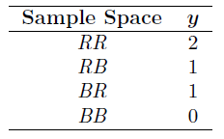
Two balls are drawn in succession without replacement from a box containing 4 red balls and 3 black balls. The possible outcomes and the values y of the random variable Y , where Y is the number of red balls, are

Slide 4

If a sample space contains a finite number of possibilities or an unending sequence with as many elements as there are whole numbers, it is called a discrete sample space.
If a sample space contains an infinite number of possibilities equal to the number of points on a line segment, it is called a continuous sample space.

Slide 5
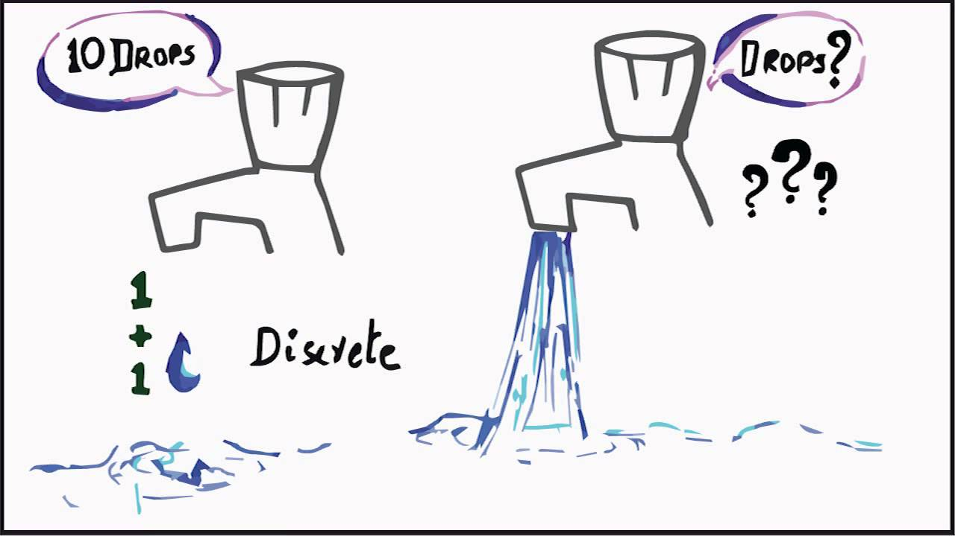

Slide 6
DISCRETE Probability Distribution

Slide 7
Discrete Probability Distributions
A discrete random variable assumes each of its values with a certain probability.
Frequently, it is convenient to represent all the probabilities of a random variable X by a formula.
Therefore, we write f(x) = P(X = x); that is, f(3) = P(X = 3).
The set of ordered pairs (x, f(x)) is called the probability function, probability mass function, or probability distribution of the discrete random variable X.

Slide 8
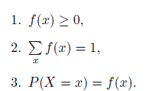
The set of ordered pairs (x, f(x)) is a probability function, probability mass function, or probability distribution of the discrete random variable X if, for each possible outcome x,

Slide 9



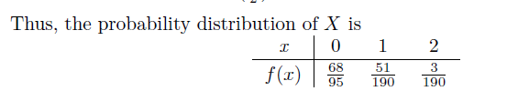
Example: A shipment of 20 similar laptop computers to a retail outlet contains 3 that are defective. If a school makes a random purchase of 2 of these computers, find the probability distribution for the number of defectives.
Solution :
Let X be a random variable whose values x are the possible numbers of defective computers purchased by the school.
Then x can only take the numbers 0, 1, and 2.

Slide 10
X | P(x)
0 | 136/190
1 | 51/190
2 | 3/190

Slide 11
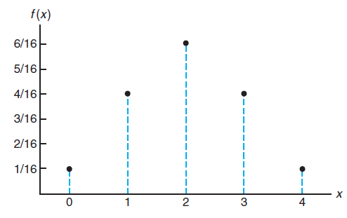
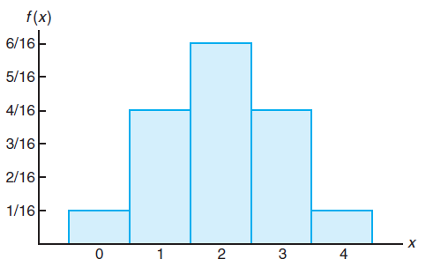
Graphical Representation of Probability Distribution
Probability Mass Function Plot
Probability Histogram
X | P(x)
0 | 1/16
1 | 4/16
2 | 6/16
3 | 4/16
4 | 1/16

Slide 12
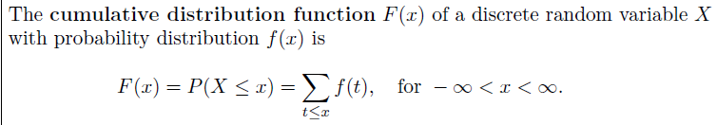
Cumulative Distribution Function

Slide 13
F(0) = f(0)= 136/190
F(1) = f(0)+f(1)= 136/190 +51/190 =187/190
F(2) = f(0)+f(1)+f(2)= 136/190 +51/190+ 3/190 =1
0 x < 0
F(x) = 136/190 0 ≤ x < 1
87/190 1 ≤ x < 2
1 x ≥ 2
X | P(x)
0 | 136/190
1 | 51/190
2 | 3/190

Slide 14

From a box containing 4 black, 3 red and 2 green balls, 3 balls are drawn. Find the probability distribution for the number of green balls.
Also find the cumulative distribution and plot probability mass function.
for x 0,1,2
X | P(x)
0 | 21/84
1 | 14/84
2 | 1/84

Slide 15
Continuous Probability Distribution

Slide 16
Continuous Probability Distributions
A continuous random variable has a probability of 0 of assuming exactly any of its values.
Consequently, its probability distribution cannot be given in tabular form.
We shall concern ourselves with computing probabilities for various intervals of continuous random variables such as P(a < X < b), P(W ≥ c), and so forth.
In dealing with continuous variables, f(x) is usually called the probability density function, or simply the density function, of X.
Note that when X is continuous,
P(a < X ≤ b) = P(a < X < b) + P(X = b) = P(a < X < b).

Slide 17
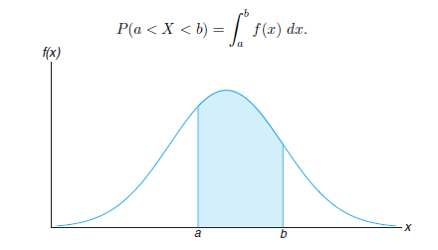
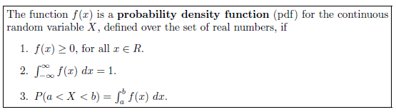

Slide 18



Example: Suppose that the error in the reaction temperature, in ◦C, for a controlled laboratory experiment is a continuous random variable X having the probability density function.
(a) Verify that f(x) is a density function.
(b) Find P(0 < X ≤ 1).
Solution:
(a) Obviously, f(x) ≥ 0. To verify condition 2 in Definition, we have
(b) Using formula 3 in Definition 3.6, we obtain

Slide 19
Assignment Questions
3.1
3.2
3.10
3.11
3.13
3.22
3.24
3.26

